Slide 1
Diagnosing and Treating Bipolar Disorder
Dr. Nakieta Lankster

Slide 2
Agenda
1
Brief hx
2
Treatment: Planning
3
Evaluation
3
3
Symptoms
Diagnosing
2
Bipolar Disorder and the Brain

Slide 3
Brief history
First researched in 1st century Greece by Aretaeus of Cappadocia (1)
17th century Theophilus Bonet “Sepuchretum” connected mania and melancholy in a condition called “manico-melancolicus.”(1)
19th century Jean-Pierre Falret described “la folie circulaire,” which translates to circular insanity. This describes people switching through severe depression and manic excitement, and is considered to be the first documented diagnosis of bipolar disorder. (1)
20th century Emil Kraepelin “Manic Depressive Insanity and Paranoia described the difference between manic-depressive and praecox, which is now known as schizophrenia. His classification of mental disorders remains the basis used by professional associations today (1)
Notes:
Later that century, Theophilus Bonet published a great work titled “Sepuchretum,” a text that drew from his experience performing 3,000 autopsies. In it, he linked mania and melancholy in a condition called “manico-melancolicus.” The first time depression and mania were connected in one disorder
French psychiatrist Jean-Pierre Falret published an article in 1851 describing what he called “la folie circulaire,” which translates to circular insanity. The article details people switching through severe depression and manic excitement, and is considered to be the first documented diagnosis of bipolar disorder.
In addition to making the first diagnosis, Falret also noted the genetic connection in bipolar disorder, something medical professionals still support to this day.
The history of bipolar disorder changed with Emil Kraepelin, a German psychiatrist who broke away from Sigmund Freud’s theory that society and the suppression of desires played a large role in mental illness. Kraepelin recognized biological causes of mental illnesses. He’s believed to be the first person to seriously study mental illness. Kraepelin’s “Manic Depressive Insanity and Paranoia” in 1921 detailed the difference between manic-depressive and praecox, which is now known as schizophrenia. His classification of mental disorders remains the basis used by professional associations today.

Slide 4


The Facts
Males
Females
Lifetime risk of suicide for bipolar dx patients is 15x that of the general population
Bipolar disorder is more common in high income countries than low income 1.4% vs 0.7%.
.
Less likely to be diagnosed with Bipolar II
Child birth can trigger a hypomanic episode in 10-20%
.
Lower rates of comorbid eating disorders
More likely to experience rapid cycling
Are more prone to manic episodes
Higher risk of lifetime alcohol use
Typically begins earlier and is more severe
2.5% of the worlds population
50%
Family history of bipolar disorder increased the risk by 10x
50%
(2,3)

Slide 5
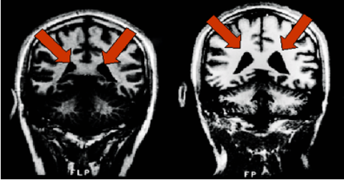
Bipolar and the brain
Lori Altshuler, director of the UCLA Mood Disorders Research Program, found that the amygdala seems to be significantly enlarged in patients with bipolar illness, along with enlarged ventricles. (Image © UCLA.) Left normal brain, right enlarged ventricles
(4)

Slide 6
Bipolar and the Brain
British researchers confirmed this in 2007. They found people diagnosed with bipolar disorder suffer from an accelerated shrinking of their brain. Imaging studies carried out four years apart showed loss of brain tissue in the areas controlling memory, face recognition and coordination. Just four weeks of treatment with lithium increases gray matter volume in the human brain, according to a study by Wayne State University School of Medicine on the bipolar brain.
Studies show that individuals diagnosed with Bipolar Disorder have different functioning in certain areas of the brain when compared to the population at large. In particular the limbic system shows consistent differences. It is the limbic system that controls emotion, motivation, memory and fear – the classic maladaptions of manic depressives. The limbic system includes:
the amygdala- (plays a key role in processing emotions, such as fear, pleasure, and anger. In addition to helping you feel particular emotions)researchers have directly stimulated the amygdalae of patients who were undergoing brain surgery, and asked them to report their impressions. The subjective experience that these patients reported most often was one of imminent danger and fear.
the hippocampus-The hippocampus helps humans process and retrieve two kinds of memory, declarative memories and spatial relationships.
the cingulate gyrus- coordinates sensory input with emotions, coordinates emotional responses to pain, regulates aggressive behavior, communication, maternal bonding, language expression, decision making
It may be that a major contributor to the disease is a failure in the way these areas of the brain communicate. In fact, over 25 studies show neurological abnormalities! These abnormalities often include things like loss of volume or loss of plasticity in the major pathways.

Slide 7
Symptoms: Manic Episode
Criteria A
A distinct period of abnormally and persistently elevated, expansive, or irritable mood and abnormally and persistent increased goal-directed activity or energy lasting at least 1 week and present most of the day nearly every day (or any duration if hospitalization is necessary).
(2)

Slide 8
Goal-directed Behavior
Behavior aimed toward the completion of a specific task or goal

Slide 9
Expansive Mood
An extreme expression of emotion characterized by inflated self importance and exaggerated behaviors.

Slide 10
Elevated Mood
A component of euphoria. Intense feelings of well being or happiness

Slide 11
Symptoms: Manic Episode
Criteria B
During the period of mood disturbance and increased energy or activity 3 or more (4 if the mood is only irritable) are present to a significant degree and represent a noticeable change in behavior.
Inflated self-esteem or grandiosity
Decreased need for sleep
More talkative
Flight of ideas
Distractibility
Increase in goal directed activity
Excessive involvement in activities that have a high potential for painful consequences
(2)

Slide 12
Flight of ideas
Speaking rapidly and jumping from one topic to another

Slide 13
Grandiosity
Superiority; an exaggerated sense of importance

Slide 14
Symptoms: Manic Episode
Criteria C
Mood disturbance causes impairment in social or occupational functioning or to necessitate hospitalization to prevent harm to self or others, or there or psychotic features.
(2)

Slide 15
Symptoms: Manic Episode
Criteria D
Episode is not attributable to the effects of a substance (including medication).
* At least one lifetime manic episode is required for the diagnosis of Bipolar I Disorder
(2)

Slide 16


Slide 17

Notes:
Mania with psychosis

Slide 18
Symptoms: Hypomanic Episode
Criteria A
A distinct period of abnormally and persistently elevated, expansive, or irritable mood and abnormally and persistently increased activity or energy, lasting at least 4 consecutive days and present most of the day, nearly every day.
(2)

Slide 19
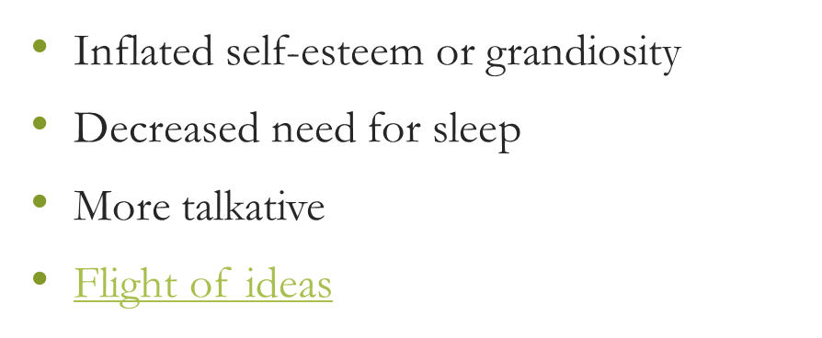
Symptoms: Hypomanic Episode
Criteria B
During the period of mood disturbance and increased energy and activity, 3 (or more) of the following symptoms (4 if the mood is only irritable) have persisted, represent a noticeable change from usual behavior, and have been present to a significant degree.
Distractibility
Increased in goal-directed
Excessive involvement in activities that have a high potential for painful consequences
(2)

Slide 20
Symptoms: Hypomanic Episode
Criteria C
Episode is associated with an unequivocal change in functioning that is uncharacteristic of the individual when not symptomatic
(2)

Slide 21
Symptoms: Hypomanic Episode
Criteria D
The disturbance in mood and change in functioning are observable by others
(2)

Slide 22
Symptoms: Hypomanic Episode
Criteria E
The episode is not severe enough to cause marked impairment in social or occupational functioning or to necessitate hospitalization. If there are psychotic features, the episode is, by definition, manic.
(2)

Slide 23
Symptoms: Hypomanic Episode
Criteria F
The episode is not attributable to the physiological effects of a substance
* Hypomanic episodes are common in Bipolar I Disorder but are not required for the diagnosis
(2)

Slide 24
Symptoms: Major Depressive Episode
Criteria A
5 (or more) of the following symptoms have been present during the same 2 week period & represent a change from previous functioning; at least one of the symptoms is depressed mood or loss of interest or pleasure
Depressed most of the day, nearly every day
Diminished interest or pleasure in all or most activities
Weight loss or gain
Recurrent thoughts of death
Insomnia or Hypersomnia
Psychomotor agitation or retardation
Fatigue
Feelings of worthlessness or excessive guilt
Diminished ability to think or concentrate
(2)
Notes:
Depressed mood is indicated subjectively or observation

Slide 25
Psychomotor agitation or retardation
“psychomotor” refers to the connections made between mental and muscle functions. Includes restless symptoms, such as skin picking or pacing around the room, that are caused by what may be described as mental tension.

Slide 26
Hypersomnia
Excessive daytime sleepiness or the inability to stay awake during the day

Slide 27
Suicidal Ideation vs Thoughts of death
Suicidal Ideation is a desire to kill oneself where as thoughts of death is a desire or wish to die (e.g., wishing to die while sleeping)

Slide 28
Symptoms: Major Depressive Episode
Criteria B
The symptoms cause clinically significant distress or impairment social, occupational, or other important areas of functioning
(2)

Slide 29
Symptoms: Major Depressive Episode
Criteria C
The episode is not attributable to the physiological effects of a substance or another medical condition
*Responses to a significant loss may include the feelings of intense resemble a depressive episode. As such, the presence of a major depressive episode in addition to the normal response to a significant loss should be carefully considered
(2)

Slide 30
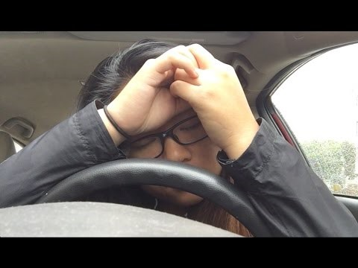

Slide 31

Notes:
Depression with psychosis

Slide 32
Bipolar I
Criteria have been met for at least one manic episode
The occurrence of the manic and major depressive episode(s) is not better explained by schizoaffective disorder, schizophrenia, schizophreniform disorder, delusional disorder, or other specified or unspecified schizophrenia spectrum and other psychotic disorder.
(2)

Slide 33
Bipolar II
Criteria have been met for at least one hypomanic episode
There has never been a manic episode
The occurrence of the hypomanic episode(s) and major depressive episode(s) is not better explained by another disorder
The symptoms of depressive or the unpredictability caused by frequent alternation between periods of depression and hypomanic causes clinically significant distress or impairment in social occupational or other important areas of functioning.

Slide 34
Cyclothymic
At least 2 yrs (at least 1 yr in children and adolescents) there have been numerous periods with hypomanic symptoms that do not meet criteria for a hypomanic episode and numerous periods with depressive symptoms that do not meet the criteria for major depressive disorder.
During the 2 year period (1 yr in children and adolescents), the hypomanic and depressive periods have been present for at least half the time and the individual has not been without the symptoms for more than 2 months
Criteria for major depressive, manic, or hypomanic episode have never been met.
The symptoms are not better explained by another disorder
The symptoms are not attributable to the physiological effects of substance
Notes:
Moody

Slide 35
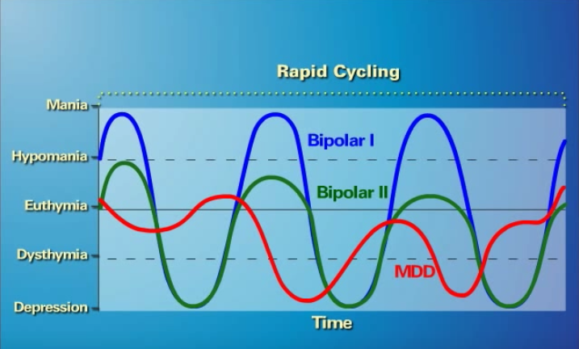
Cyclothymic
Notes:
Yellow is Cyclothymic

Slide 36

Rapid Cycling

Slide 37
Differential diagnoses
Generalized Anxiety Disorder-Do they have pressured speech?
Panic Disorder-Got depression? Are the symptoms mostly physiological?
Posttraumatic Stress Disorder- Is there a precipitating event? Is it mostly trauma related symptomology?
Substance/medication-induced bipolar disorder-did this start after they ingested a substance?
Attention-deficit/hyperactivity disorder-Is depression present?
Major Depressive Disorder- Any do they meet the criteria for mania or hypomania?

Slide 38
Differential diagnosing: Borderline Personality Disorder
Impulsivity
Mood disturbance
Chronic feelings of emptiness
Inappropriate, intense anger or difficulty controlling anger
Impulsivity in at least two areas that that are potentially self-damaging
Issues with abandonment
Unstable personal relationships
Transient paranoid ideation
Recurrent suicidal behavior

Slide 39
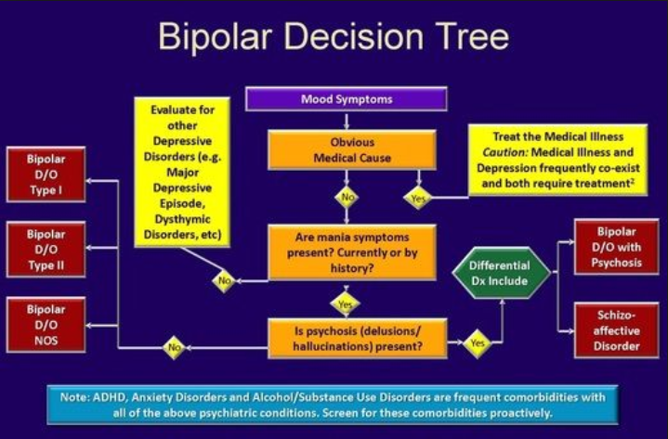
Decision Tree
From DSM IV

Slide 40
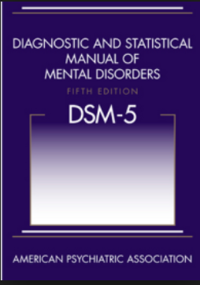
Coding
Click the picture to be taken to the ICD10Data.com website

Slide 41
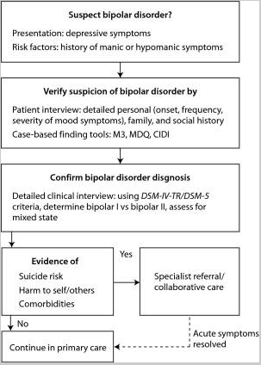
Treatment Planning: Initial session

Slide 42
Treatment Planning: Goals
Create objective measurable goals (Ex: “Patient will comply with prescribed medication 7 of 7 days per week.” Patient will reduce marijuana consumption from approximately 8 oz per week to approximately 3 oz per week”).
Goals should be set (and evaluated) based upon patients’ current level of functioning and prognosis (e.g., a severely depressed patient with a history of suicide attempts should not have the goals of “Patient will report euthymic mood 3 of 5 days per week” or “Patient will participate in [insert specific coping method] to cope with depressive symptomology 5/5 occurrences”).
Goals are flexible and should be re-evaluated regularly to confirm that they still meet the patients needs and adjusted accordingly.

Slide 43
Treatment Plan: Goals
Goals should be tailored to the patient, but you don’t have to reinvent the wheel!
Goals should address several aspects of the patients life (e.g., occupation, social, medication/physiological, family conflicts, etc.)

Slide 44
Treatment Plan: Goals and Objectives (Inpatient)
Resolution of depressive symptoms
Resolution of manic/hypomanic symptoms
Patient will contract for safety with staff at least once per shift
Patient will identify two coping skills related to (specific stressor)
Patient will report at least six hours of restful sleep each night
Patient will eat at least two out of three meals a day
Patient will attend at least two activities or groups a day
Patient will reality test with staff for 10 minutes a shift
Patient will report any perceived conflict to staff
Patient will report at least six hours of restful sleep per night
Patient will remain in at least two groups per day for the entire length of the group
Patient will eat at least two out of three meals a day
Patient will reality test (specific belief) for at least 10 minutes a day with staff
Patient will participate in at least three groups/activities a day and comply with group rules
Patient will dress in an appropriate manner on a daily basis

Slide 45
Treatment Goals and Objectives (Outpatient)
Decrease in Depressive Symptoms
Decrease in Mania/Hypomania
Be free of suicidal thoughts
Call crisis hotline if having suicidal thoughts
Report feeling more positive about self and abilities
Get 7-8 hours of restful sleep every night
Avoid napping/sleeping to escape other people and activities
Shower, dress, and then do something every day
Report feeling happy/better overall mood
Make short and simple “to do” lists and complete three tasks each day
Be free of any behavior that could result in loss of job
Remain free of behaviors which would lead to arrest
Comply with all aspects of probation/parole and avoid behavior that could violate
Share two positive experiences each week in which client is proud of how he/she has behaved
Learn to express feelings verbally without acting out
Speak in a clear and concise manner so others fully understand him/her
Learn to express feelings verbally without acting out

Slide 46

Medication
Medications used to treat Bipolar Disorder:
Anticonvulsant- Prevents or controls seizures, relieves pain, and treats symptoms of certain psychiatric disorders (Ex: Risperidone).
Antipsychotic- Reduces or improves the symptoms of certain psychiatric conditions (Ex: Lamotrigine).
Selective Serotonin Reuptake Inhibitor (SSRI)-Eases symptoms of depressed mood and anxiety (Ex: Fluoxetine).

Slide 47
Evidence Based Treatment
♦Mania should be treated with lithium, divalproex, or an atypical antipsychotic medication.
♦Bipolar depression should be treated with quetiapine, olanzapine/fluoxetine combination, or lamotrigine.
♦Once mood episodes are successfully treated, effective acute phase medications should be continued for maintenance of euthymia with appropriate medication monitoring.
♦All patients should be offered individual or group psychoeducation to prevent relapse and improve treatment adherence.
(5)

Slide 48
Therapy: Acceptance and Commitment Therapy (ACT) and Bipolar Disorder
There are six processes which are seen to inhibit psychological flexibility: (a) lack of chosen values, (b) experiential avoidance, (c) cognitive fusion, (d) attachment to the conceptualized self, (e) inflexible attention, (f) inaction, impulsivity, or avoidant persistence. The opposites of these processes facilitate psychological flexibility: (a) values, (b) acceptance, (c) defusion, (d) perspective taking/ sense of self, (e) flexible attention to the present moment, and (f) committed action

Slide 49
Therapy: Dialectic Behavioral Therapy (DBT) and Bipolar Disorder
Dialectical behavioral therapy (DBT) provides clients with new skills to manage painful emotions and decrease conflict in relationships. DBT specifically focuses on providing therapeutic skills in four key areas. First, mindfulness focuses on improving an individual's ability to accept and be present in the current moment. Second, distress tolerance is geared toward increasing a person’s tolerance of negative emotion, rather than trying to escape from it. Third, emotion regulation covers strategies to manage and change intense emotions that are causing problems in a person’s life. Fourth, interpersonal effectiveness consists of techniques that allow a person to communicate with others in a way that is assertive, maintains self-respect, and strengthens relationships.

Slide 50
Measuring Treatment Outcomes
Treatment effectiveness should be measured on the individual patients prognosis and performance of goals.
Keep in mind the evolution of the patients diagnosis
Perform regular Mental Status Examinations
“According to the researchers, these results indicate that in spite of modern, evidence-based treatment [designed to create remission as a final outcome], bipolar disorder remains a highly recurrent, predominantly depressive illness.” –NIMH
This isn’t about “curing” it’s about harm reduction and improvement of quality of life.

Slide 51
Vignette A
A 35 year old male is brought in by his wife because he has been taking out various loans to start a few small businesses. Over the past two weeks, he comes home at 3am from work and leaves at 6am and often compared his business ventures to those of Bill Gates. On exam he is easily distracted, speaks quickly and says he has to get home as he is close to discovering "the most important invention of the 21st century." In the past he has had a few episodes in which he felt hopeless and tried to commit suicide

Slide 52
Answer to A
BIPOLAR DISORDER I: Note difference between bipolar I and bipolar II--> if there is a history of true mania, then it is bipolar I (BPII has only hypomania);
What might be some helpful interventions fort this patient?

Slide 53
Vignette B
A 28 year old graduate student states that he has his "ups and downs." Further questioning reveals that at times over the past 2 years he has had episodes of extreme happiness in which he would party every day and felt as if he was "full of energy." He also describes being "down in the dumps" at times for no apparent reason. He has never been hospitalized for psychiatric reasons, nor has he had suicidal thoughts or attempted to commit suicide
Notes:
CYCLOTHYMIA:
Alternating dysthmia or hypomania, chronic

Slide 54
Vignette C
A 28-year-old single female who works as a manager for a city government has struggled with an unstable self-image, chronic feelings of emptiness, and difficulties maintaining close romantic relationships for all of her adult life. However, she has a few close female friends and is considered a good worker. Extremely self-critical, she attempts to boost her self-esteem by seeking the approval of others. She has been told that she is "needy and often seems desperate," which leads to some difficulties in maintaining romantic and other close relationships, although she often does not understand what she does that makes this impression. She experiences fluctuating strong emotions, such as panic, fear, depression, and anger in response to interpersonal disappointments. She has made several suicidal gestures by cutting herself in the past couple of years when stressed by the ending of a relationship.
Notes:
This patient would likely meet criteria in DSM-5 for borderline personality disorder, but her level of personality functioning might be rated as less impaired than that of the more typical borderline patient, with enhanced prospects for successful treatment.

Slide 55
References
Krans, B. & Cherney, K. (2018). The history of bipolar disorder. Retrieved from https://www.healthline.com/health/bipolar-disorder/history-bipolar
American Psychiatric Association. (2013). Diagnostic and statistical manual of mental disorders (5th ed.). Arlington, VA: American Psychiatric Association.
Sheehan, J. (n.d.) https://www.everydayhealth.com/bipolar-disorder/bipolar-disorder-and-gender-differences.aspx
https://www.bipolar-lives.com/bipolar-brain-imaging.html
“The Clinical Management of Bipolar Disorder: A Review of Evidence-Based Guidelines” Kevin R Connolly, MD and Michael E Thase, MD
https://www.psychologytoday.com/us/therapy-types/dialectical-behavior-therapy
ICD10Data.com
Hayes, S. C. & Lillis, J. (2012). Acceptance and commitment therapy. Washington, DC: American Psychological Association.

Slide 56


